Slide 1



Source of Slides: Introduction to Automata Theory, Languages, and Computation
By John E. Hopcroft, Rajeev Motwani and Jeffrey D. Ullman

Slide 2

Turing Machine
Church-Turing’s Thesis
Any mathematical problem solving that can be described by an algorithm can be modeled by a Turing Machine.
Dept. of Computer Science & IT, FUUAST Theory of Computation

Slide 3
Turing Machine
Types of Turing Machine
1) Multiple track
2) Shift over Turing Machine
3) Nondeterministic
4) Two way Turing Machine
5) Multitape Turing Machine
6) Multidimensional Turing Machine
7) Composite Turing Machine
8) Universal Turing Machine
Dept. of Computer Science & IT, FUUAST Theory of Computation

Slide 4

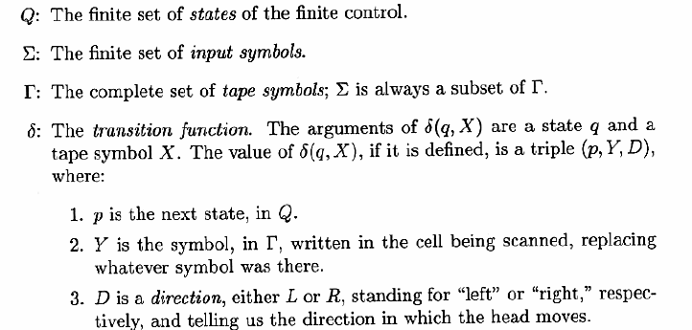
Turing Machine
Formal Definition
Dept. of Computer Science & IT, FUUAST Theory of Computation

Slide 5
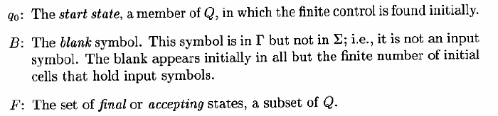
Turing Machine
Dept. of Computer Science & IT, FUUAST Theory of Computation

Slide 6
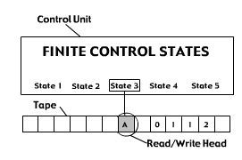
Turing Machine
Steps
Start in state q₀
Read symbol under head
Write new symbol
Shift left/right
Enter new state q_{j}
Dept. of Computer Science & IT, FUUAST Theory of Computation

Slide 7
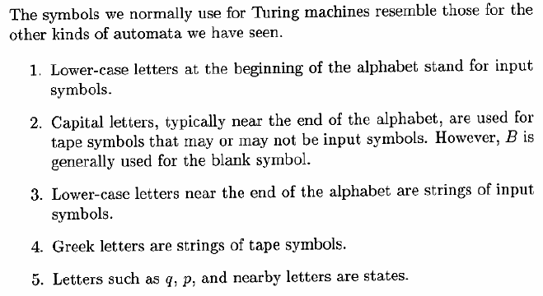
Turing Machine
Notational Conventions For Turing Machines
Dept. of Computer Science & IT, FUUAST Theory of Computation

Slide 8
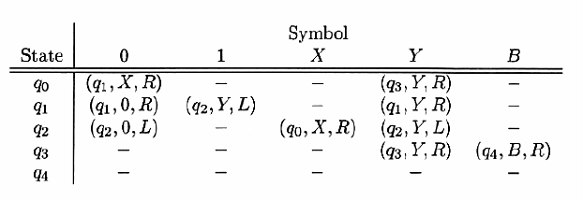
Turing Machine
A Turing Machine M that accepts the language { 0^{n}1^{n} | n ≥0 }
Dept. of Computer Science & IT, FUUAST Theory of Computation

Slide 9


Turing Machine
Moves for input 0011:
Moves for input 0010:
Dept. of Computer Science & IT, FUUAST Theory of Computation

Slide 10
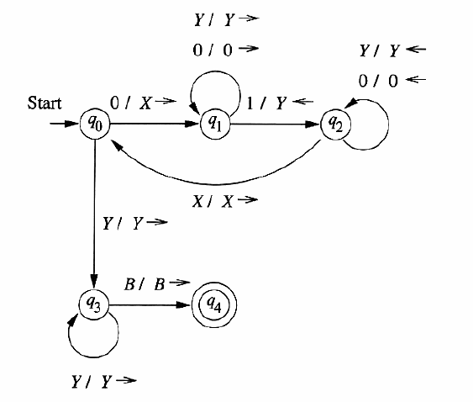
Turing Machine
Transition Diagram for 0011 input
Dept. of Computer Science & IT, FUUAST Theory of Computation

Slide 11
Turing Machine
A Turing Machine M that accepts the language { 0^{n}1^{n} | n ≥0 }
0 0 1 1 B B
q₀
Dept. of Computer Science & IT, FUUAST Theory of Computation

Slide 12
Turing Machine
A Turing Machine M that accepts the language { 0^{n}1^{n} | n ≥0 }
X 0 1 1 B B
q₁
Dept. of Computer Science & IT, FUUAST Theory of Computation

Slide 13
Turing Machine
A Turing Machine M that accepts the language { 0^{n}1^{n} | n ≥0 }
X 0 1 1 B B
q₁
Dept. of Computer Science & IT, FUUAST Theory of Computation

Slide 14
Turing Machine
A Turing Machine M that accepts the language { 0^{n}1^{n} | n ≥0 }
X 0 Y 1 B B
q₂
Dept. of Computer Science & IT, FUUAST Theory of Computation

Slide 15
Turing Machine
A Turing Machine M that accepts the language { 0^{n}1^{n} | n ≥0 }
X 0 Y 1 B B
q₂
Dept. of Computer Science & IT, FUUAST Theory of Computation

Slide 16
Turing Machine
A Turing Machine M that accepts the language { 0^{n}1^{n} | n ≥0 }
X 0 Y 1 B B
q₀
Dept. of Computer Science & IT, FUUAST Theory of Computation

Slide 17
Turing Machine
A Turing Machine M that accepts the language { 0^{n}1^{n} | n ≥0 }
X 0 Y 1 B B
q₀
Dept. of Computer Science & IT, FUUAST Theory of Computation

Slide 18
Turing Machine
A Turing Machine M that accepts the language { 0^{n}1^{n} | n ≥0 }
X X Y 1 B B
q₁
Dept. of Computer Science & IT, FUUAST Theory of Computation

Slide 19
Turing Machine
A Turing Machine M that accepts the language { 0^{n}1^{n} | n ≥0 }
X X Y 1 B B
q₁
Dept. of Computer Science & IT, FUUAST Theory of Computation

Slide 20
Turing Machine
A Turing Machine M that accepts the language { 0^{n}1^{n} | n ≥0 }
X X Y Y B B
q₂
Dept. of Computer Science & IT, FUUAST Theory of Computation

Slide 21
Turing Machine
A Turing Machine M that accepts the language { 0^{n}1^{n} | n ≥0 }
X X Y Y B B
q₂
Dept. of Computer Science & IT, FUUAST Theory of Computation

Slide 22
Turing Machine
A Turing Machine M that accepts the language { 0^{n}1^{n} | n ≥0 }
X X Y Y B B
q₀
Dept. of Computer Science & IT, FUUAST Theory of Computation

Slide 23
Turing Machine
A Turing Machine M that accepts the language { 0^{n}1^{n} | n ≥0 }
X X Y Y B B
q₀
Dept. of Computer Science & IT, FUUAST Theory of Computation

Slide 24
Turing Machine
A Turing Machine M that accepts the language { 0^{n}1^{n} | n ≥0 }
X X Y Y B B
q₃
Dept. of Computer Science & IT, FUUAST Theory of Computation

Slide 25
Turing Machine
A Turing Machine M that accepts the language { 0^{n}1^{n} | n ≥0 }
X X Y Y B B
q₃
Dept. of Computer Science & IT, FUUAST Theory of Computation

Slide 26
Turing Machine
A Turing Machine M that accepts the language { 0^{n}1^{n} | n ≥0 }
X X Y Y B B
q₄
Dept. of Computer Science & IT, FUUAST Theory of Computation

Slide 27
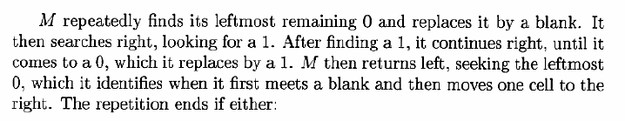
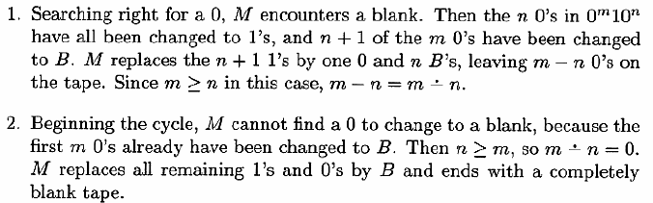
Pushdown Automata
A Turing Machine M computes a function ( proper subtraction) for 0^{m}10^{n} on the tape.
means if m ≥ n then m - n else if m < n then 0
Dept. of Computer Science & IT, FUUAST Theory of Computation

Slide 28

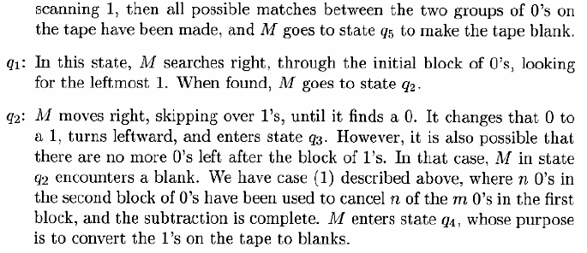
Turing Machine
Evaluating function
Dept. of Computer Science & IT, FUUAST Theory of Computation

Slide 29
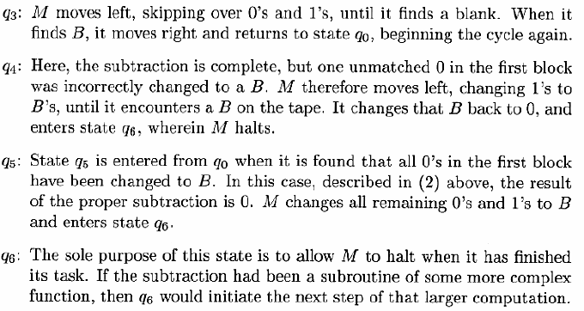
Turing Machine
Evaluating function
Dept. of Computer Science & IT, FUUAST Theory of Computation

Slide 30
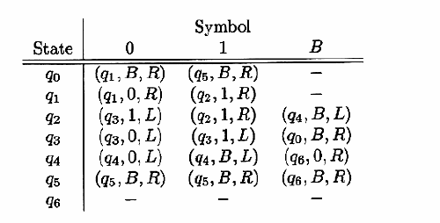
Turing Machine
Transition Table for the function
Dept. of Computer Science & IT, FUUAST Theory of Computation

Slide 31
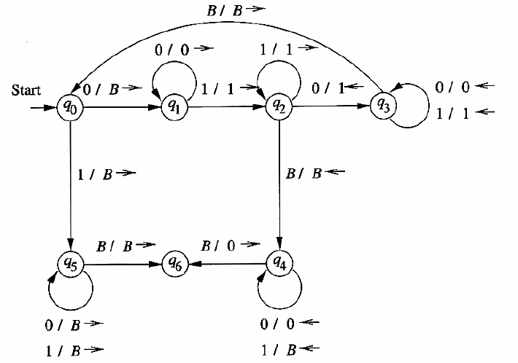
Turing Machine
Transition Diagram for
Dept. of Computer Science & IT, FUUAST Theory of Computation

Slide 32
Turing Machine
Transition Table for the function
Transition Diagram for
Dept. of Computer Science & IT, FUUAST Theory of Computation

Slide 33
Turing Machine
Evaluating function
0 0 0 0 0 1 0 0 0 B B
q₀
Dept. of Computer Science & IT, FUUAST Theory of Computation

Slide 34
Turing Machine
Evaluating function
B 0 0 0 0 1 0 0 0 B B
q₁
Dept. of Computer Science & IT, FUUAST Theory of Computation

Slide 35
Turing Machine
Evaluating function
B 0 0 0 0 1 0 0 0 B B
q₁
Dept. of Computer Science & IT, FUUAST Theory of Computation

Slide 36
Turing Machine
Evaluating function
B 0 0 0 0 1 0 0 0 B B
q₁
Dept. of Computer Science & IT, FUUAST Theory of Computation

Slide 37
Turing Machine
Evaluating function
B 0 0 0 0 1 0 0 0 B B
q₁
Dept. of Computer Science & IT, FUUAST Theory of Computation

Slide 38
Turing Machine
Evaluating function
B 0 0 0 0 1 0 0 0 B B
q₁
Dept. of Computer Science & IT, FUUAST Theory of Computation

Slide 39
Turing Machine
Evaluating function
B 0 0 0 0 1 0 0 0 B B
q₂
Dept. of Computer Science & IT, FUUAST Theory of Computation

Slide 40
Turing Machine
Evaluating function
B 0 0 0 0 1 1 0 0 B B
q₃
Dept. of Computer Science & IT, FUUAST Theory of Computation

Slide 41
Turing Machine
Evaluating function
B 0 0 0 0 1 1 0 0 B B
q₃
Dept. of Computer Science & IT, FUUAST Theory of Computation

Slide 42
Turing Machine
Evaluating function
B 0 0 0 0 1 1 0 0 B B
q₃
Dept. of Computer Science & IT, FUUAST Theory of Computation

Slide 43
Turing Machine
Evaluating function
B 0 0 0 0 1 1 0 0 B B
q₃
Dept. of Computer Science & IT, FUUAST Theory of Computation

Slide 44
Turing Machine
Evaluating function
B 0 0 0 0 1 1 0 0 B B
q₃
Dept. of Computer Science & IT, FUUAST Theory of Computation

Slide 45
Turing Machine
Evaluating function
B 0 0 0 0 1 1 0 0 B B
q₃
Dept. of Computer Science & IT, FUUAST Theory of Computation

Slide 46
Turing Machine
Evaluating function
B 0 0 0 0 1 1 0 0 B B
q₀
Dept. of Computer Science & IT, FUUAST Theory of Computation

Slide 47
Turing Machine
Evaluating function
B B 0 0 0 1 1 0 0 B B
q₁
Dept. of Computer Science & IT, FUUAST Theory of Computation

Slide 48
Turing Machine
Evaluating function
B B 0 0 0 1 1 0 0 B B
q₁
Dept. of Computer Science & IT, FUUAST Theory of Computation

Slide 49
Turing Machine
Evaluating function
B B 0 0 0 1 1 0 0 B B
q₁
Dept. of Computer Science & IT, FUUAST Theory of Computation

Slide 50
Turing Machine
Evaluating function
B B 0 0 0 1 1 0 0 B B
q₁
Dept. of Computer Science & IT, FUUAST Theory of Computation

Slide 51
Turing Machine
Evaluating function
B B 0 0 0 1 1 0 0 B B
q₂
Dept. of Computer Science & IT, FUUAST Theory of Computation

Slide 52
Turing Machine
Evaluating function
B B 0 0 0 1 1 0 0 B B
q₂
Dept. of Computer Science & IT, FUUAST Theory of Computation

Slide 53
Turing Machine
Evaluating function
B B 0 0 0 1 1 0 0 B B
q₂
Dept. of Computer Science & IT, FUUAST Theory of Computation

Slide 54
Turing Machine
Evaluating function
B B 0 0 0 1 1 1 0 B B
q₃
Dept. of Computer Science & IT, FUUAST Theory of Computation

Slide 55
Turing Machine
Evaluating function
B B 0 0 0 1 1 1 0 B B
q₃
Dept. of Computer Science & IT, FUUAST Theory of Computation

Slide 56
Turing Machine
Evaluating function
B B 0 0 0 1 1 1 0 B B
q₃
Dept. of Computer Science & IT, FUUAST Theory of Computation

Slide 57
Turing Machine
Evaluating function
B B 0 0 0 1 1 1 0 B B
q₃
Dept. of Computer Science & IT, FUUAST Theory of Computation

Slide 58
Turing Machine
Evaluating function
B B 0 0 0 1 1 1 0 B B
q₃
Dept. of Computer Science & IT, FUUAST Theory of Computation

Slide 59
Turing Machine
Evaluating function
B B 0 0 0 1 1 1 0 B B
q₀
Dept. of Computer Science & IT, FUUAST Theory of Computation

Slide 60
Turing Machine
Evaluating function
B B B 0 0 1 1 1 0 B B
q₁
Dept. of Computer Science & IT, FUUAST Theory of Computation

Slide 61
Turing Machine
Evaluating function
B B B 0 0 1 1 1 0 B B
q₁
Dept. of Computer Science & IT, FUUAST Theory of Computation

Slide 62
Turing Machine
Evaluating function
B B B 0 0 1 1 1 0 B B
q₁
Dept. of Computer Science & IT, FUUAST Theory of Computation

Slide 63
Turing Machine
Evaluating function
B B B 0 0 1 1 1 0 B B
q₂
Dept. of Computer Science & IT, FUUAST Theory of Computation

Slide 64
Turing Machine
Evaluating function
B B B 0 0 1 1 1 0 B B
q₂
Dept. of Computer Science & IT, FUUAST Theory of Computation

Slide 65
Turing Machine
Evaluating function
B B B 0 0 1 1 1 0 B B
q₂
Dept. of Computer Science & IT, FUUAST Theory of Computation

Slide 66
Turing Machine
Evaluating function
B B B 0 0 1 1 1 1 B B
q₃
Dept. of Computer Science & IT, FUUAST Theory of Computation

Slide 67
Turing Machine
Evaluating function
B B B 0 0 1 1 1 1 B B
q₃
Dept. of Computer Science & IT, FUUAST Theory of Computation

Slide 68
Turing Machine
Evaluating function
B B B 0 0 1 1 1 1 B B
q₃
Dept. of Computer Science & IT, FUUAST Theory of Computation

Slide 69
Turing Machine
Evaluating function
B B B 0 0 1 1 1 1 B B
q₃
Dept. of Computer Science & IT, FUUAST Theory of Computation

Slide 70
Turing Machine
Evaluating function
B B B 0 0 1 1 1 1 B B
q₃
Dept. of Computer Science & IT, FUUAST Theory of Computation

Slide 71
Turing Machine
Evaluating function
B B B 0 0 1 1 1 1 B B
q₃
Dept. of Computer Science & IT, FUUAST Theory of Computation

Slide 72
Turing Machine
Evaluating function
B B B 0 0 1 1 1 1 B B
q₀
Dept. of Computer Science & IT, FUUAST Theory of Computation

Slide 73
Turing Machine
Evaluating function
B B B B 0 1 1 1 1 B B
q₁
Dept. of Computer Science & IT, FUUAST Theory of Computation

Slide 74
Turing Machine
Evaluating function
B B B B 0 1 1 1 1 B B
q₁
Dept. of Computer Science & IT, FUUAST Theory of Computation

Slide 75
Turing Machine
Evaluating function
B B B B 0 1 1 1 1 B B
q₂
Dept. of Computer Science & IT, FUUAST Theory of Computation

Slide 76
Turing Machine
Evaluating function
B B B B 0 1 1 1 1 B B
q₂
Dept. of Computer Science & IT, FUUAST Theory of Computation

Slide 77
Turing Machine
Evaluating function
B B B B 0 1 1 1 1 B B
q₂
Dept. of Computer Science & IT, FUUAST Theory of Computation

Slide 78
Turing Machine
Evaluating function
B B B B 0 1 1 1 1 B B
q₂
Dept. of Computer Science & IT, FUUAST Theory of Computation

Slide 79
Turing Machine
Evaluating function
B B B B 0 1 1 1 1 B B
q₄
Dept. of Computer Science & IT, FUUAST Theory of Computation

Slide 80
Turing Machine
Evaluating function
B B B B 0 1 1 1 B B B
q₄
Dept. of Computer Science & IT, FUUAST Theory of Computation

Slide 81
Turing Machine
Evaluating function
B B B B 0 1 1 B B B B
q₄
Dept. of Computer Science & IT, FUUAST Theory of Computation

Slide 82
Turing Machine
Evaluating function
B B B B 0 1 B B B B B
q₄
Dept. of Computer Science & IT, FUUAST Theory of Computation

Slide 83
Turing Machine
Evaluating function
B B B B 0 B B B B B B
q₄
Dept. of Computer Science & IT, FUUAST Theory of Computation

Slide 84
Turing Machine
Evaluating function
B B B B 0 B B B B B B
q₄
Dept. of Computer Science & IT, FUUAST Theory of Computation

Slide 85
Turing Machine
Evaluating function
B B B 0 0 B B B B B B
q₆
Final State
Dept. of Computer Science & IT, FUUAST Theory of Computation

Slide 86
Turing Machine
End of Simulation
Dept. of Computer Science & IT, FUUAST Theory of Computation

Slide 87
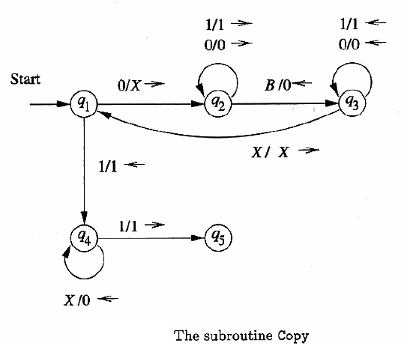
Turing Machine
Multiplication
0^{m}10^{n}1
Dept. of Computer Science & IT, FUUAST Theory of Computation

Slide 88
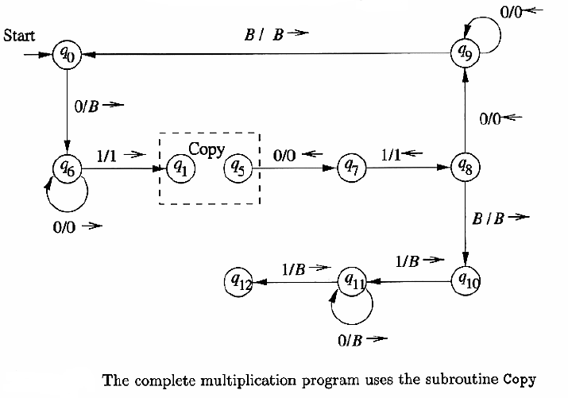
Turing Machine
Multiplication
0^{m}10^{n}1
Dept. of Computer Science & IT, FUUAST Theory of Computation

Slide 89
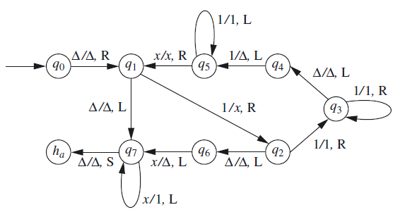
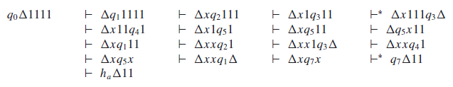
Turing Machine
Dept. of Computer Science & IT, FUUAST Theory of Computation

Slide 90
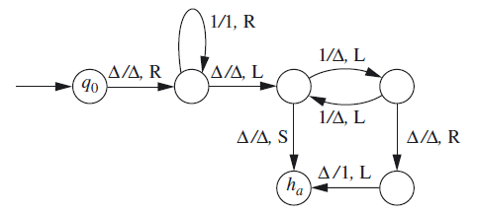

Turing Machine
Dept. of Computer Science & IT, FUUAST Theory of Computation

Slide 91
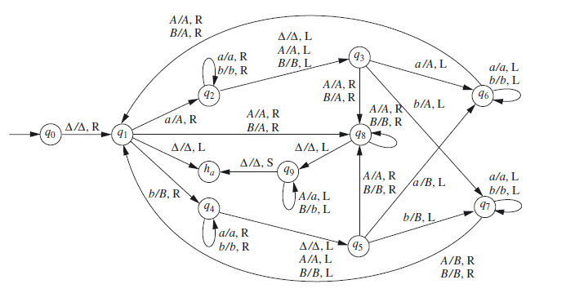
Turing Machine
Dept. of Computer Science & IT, FUUAST Theory of Computation

Slide 92
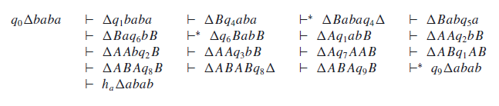
Turing Machine
Dept. of Computer Science & IT, FUUAST Theory of Computation

Slide 93
Turing Machine
Variants of Turing Machine
Multitape Turing Machine:
A normal TM is a 7-tuple
(Q, Σ, Γ, δ, q₀, q_{accept}, q_{reject}) where:
  everything is the same as a TM except the transition function:
  δ: Q x Γ^{k} → Q x Γ^{k} x {L, R}^{k}
  δ(q_{i}, a₁,a₂,…,a_{k}) = (q_{j}, b₁,b₂,…,b_{k}, L, R,…, L) =
  “in state q_{i}, reading a₁,a₂,…,a_{k} on k tapes, move to state q_{j}, write b₁,b₂,…,b_{k} on k tapes, move L, R on k tapes as specified.”
Dept. of Computer Science & IT, FUUAST Theory of Computation

Slide 94
Turing Machine
k-tape TM
input tape
…
0
1
1
0
0
1
1
1
0
1
0
0
finite control
k read/write heads
q₀
…
0
1
1
0
0
1
…
0
1
1
0
0
1
1
1
0
1
0
0
“work tapes”
…
…
0
Dept. of Computer Science & IT, FUUAST Theory of Computation

Slide 95
Turing Machine
Informal description of k-tape TM:
  Input written on left-most squares of tape #1
  Rest of squares are blank on all tapes
  At each point, take a step determined by
    current k symbols being read on k tapes
    current state of finite control
  A step consists of
    writing k new symbols on k tapes
    moving each of k read/write heads left or right
    changing state
Dept. of Computer Science & IT, FUUAST Theory of Computation

Slide 96
Turing Machine
Theorem: Every k-tape TM has an equivalent single-tape TM.
Proof: Simulate k-tape TM on a 1-tape TM.
. . .
a
b
a
b
add new symbol x for each old x
marks location of “virtual heads”
(input tape)
a
a
. . .
. . .
b
b
c
d
#
a
b
a
b
#
a
a
#
b
b
c
d
#
. . .
Dept. of Computer Science & IT, FUUAST Theory of Computation

Slide 97
Turing Machine
Theorem:
The time taken by the one-tape TM to simulate n moves of the k-tape TM is O(n²).
Dept. of Computer Science & IT, FUUAST Theory of Computation

Slide 98
Turing Machine
Nondeterministic Turing Machine (NTM):
A nondeterministic Turing Machine (NTM) differs from the deterministic variety by having a transition function δ such that for each state q and tape symbol X, δ(q, X) is a set of triples
{(q₁,Y₁,D₁), (q₂,Y₂,D₂), ……….. (q_{k},Y_{k},D_{k})}
Where k is any finite integer. The NTM can choose, at each step, any of the triples to be the next move. It cannot, however, pick a state from one, a tape symbol from another, a the direction from yet another.
Dept. of Computer Science & IT, FUUAST Theory of Computation

Slide 99
Turing Machine
Theorem: Every NTM has an equivalent (deterministic) TM.
Proof: Simulate NTM with a deterministic TM
C_{start}
computations of M are a tree
nodes are configurations
fanout is b = maximum number of choices in transition function
leaves are accept/reject configurations.
rej
acc
Dept. of Computer Science & IT, FUUAST Theory of Computation

Slide 100
Turing Machine
Simulating NTM M with a deterministic TM:
Breadth-first search of tree
if M accepts: we will encounter accepting leaf and accept
if M rejects: we will encounter all rejecting leaves, finish traversal of tree, and reject
if M does not halt on some branch: we will not halt as that branch is infinite…
Dept. of Computer Science & IT, FUUAST Theory of Computation

Slide 101
Turing Machine
Simulating NTM M with a deterministic TM:
  use a 3 tape TM:
    tape 1: input tape (read-only)
    tape 2: simulation tape (copy of M’s tape at point corresponding to some node in the tree)
    tape 3: which node of the tree we are exploring (string in {1,2,…b}*)
  Initially, tape 1 has input, others blank
Dept. of Computer Science & IT, FUUAST Theory of Computation

Slide 102
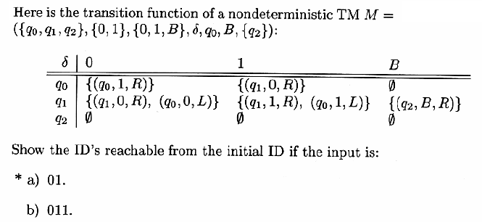
Turing Machine
Dept. of Computer Science & IT, FUUAST Theory of Computation

Slide 103
Turing Machine
Turing Machine and Computer
A computer can simulate Turing Machine.
A Turing Machine can simulate a computer.
Dept. of Computer Science & IT, FUUAST Theory of Computation

Slide 104
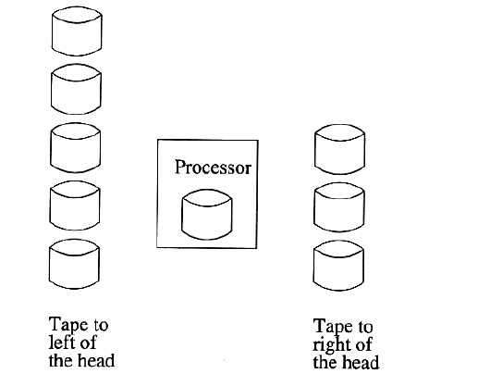
Turing Machine
Simulating a Turing Machine by Computer
Dept. of Computer Science & IT, FUUAST Theory of Computation

Slide 105
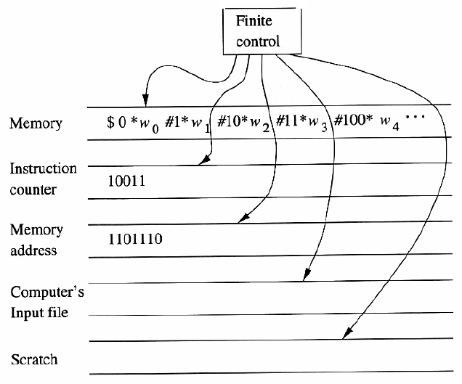
Turing Machine
Simulating a Computer by Turing Machine
Both addresses and contents are written in binary. The marker symbol * and # are used to find the ends of addresses and contents. Another marker,$, indicates the beginning of the sequence of addresses and contents
Dept. of Computer Science & IT, FUUAST Theory of Computation

Slide 106
Turing Machine
Universal Turing Machine
A universal Turing machine is a Turing machine T_{u} that works as follows. It is assumed to receive an input string of the form e(T )e(z), where T is an arbitrary TM, z is a string over the input alphabet of T , and e is an encoding function whose values are strings in {0, 1}∗. The computation performed by T_{u} on this input string satisfies these two properties:
1. T_{u} accepts the string e(T )e(z) if and only if T accepts z.
2. If T accepts z and produces output y, then T_{u} produces output e(y).
Dept. of Computer Science & IT, FUUAST Theory of Computation

Slide 107
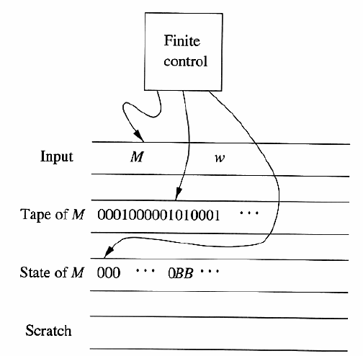
Turing Machine
Universal Turing Machine
Dept. of Computer Science & IT, FUUAST Theory of Computation

Slide 108
Turing Machine
END
Dept. of Computer Science & IT, FUUAST Theory of Computation

